Slide 1
Population-based Models for COVID-19 Hospitalization Forecast in British Columbia
Health Sector Information, Analysis and Reporting Division | Ministry of Health
May 12th, 2021
Samantha Magnus, Director
Yongcai Liu, Senior Economist

Slide 2
Territorial Acknowledgement
“Because this Territorial Title cannot be bought or sold, we therefore declare in our final words that our Saanich Territorial Homeland and inherent rights are not for sale.”
Saanich Indian Territorial Declaration, 1987
W̱SÁNEĆ Carving by STOLȻEȽ (John Elliott) depicting a Reef Net Captain carrying cedar rope.
Notes:
The W̱SÁNEĆ People are Salt Water People. The Sea was very important to our way of life. Traditionally the W̱SÁNEĆ People had homes throughout the San Juan Islands and on the east and north coasts of the Saanich Peninsula.

Slide 3
Territorial Acknowledgement
Songhees drummer, Victoria Day parade, 2015
Photo credit: Lotus Johnson
Notes:
2007 - The Songhees and Esquimalt Land Settlement
​​​​​​In 2001, the Esquimalt and Songhees ​Nations filed a lawsuit against Canada and British Columbia that alleged both governments had disregarded reserve land originally set aside during the Douglas Treaties​ in the 1850s. The lawsuit claimed that James Douglas, then Governor of the Colony of Vancouver Island, unlawfully took back a portion of the reserve land he had previously designated and used it to develop the Colonial Administration Buildings ​(now the Parliament Buildings).
n 2007, an agreement was reached between the Esquimalt and Songhees Nations and the Canadian and B.C. governments to settle the land claims outside of the court system. All parties agreed that the Canadian and B.C. governments would transfer $31.5 million to the two nations for purchasing land elsewhere, compensating the Esquimalt and Songhees Nations for what was argued to be an infringement on their historical treaty rights.

Slide 4
Presenters
Samantha Magnus
Director, Methodologies & Cross-Sector Analysis
Yongcai Liu
Senior Economist
Methodologies & Cross-Sector Analysis

Slide 5
Outline
Part One
Introduction to ministry owned datasets –
CIHI’s Population Grouping Methodology (CPOP)
Heath System Matrix (HSM)
Overview of applications using CPOP and HSM
Part Two
COVID-19 daily hospitalization forecasts based on a logistic model
COVID-19 ICU admission forecast based on a negative binominal model

Slide 6
Why categorize people and patients?
Notes:
To answer this question, I want to back up and ask another question, why do we categorize people and patients>?

Slide 7
We ‘put’ patients in boxes to understand patients needs at a population level
Notes:
We can’t design a system for each individual, but rather need to understand population needs in the aggregate

Slide 8
Introducing CIHI’s Population Grouping Methodology (CPOP) and Heath System Matrix (HSM)
Population segmentation is a concept taken from marketing (market segmentation) – a means of better understanding and catering to customers with similar demand for products and services.
Population segmentation or grouping is patient-focused and includes the whole population.
Goes beyond any one part of the health system to facilitate understanding the holistic needs of patients within each cohort.
Both CIHI’s Population Grouping Methodology and Health System Matrix help us categorize the population into segments or groups, with different focuses

Slide 9
Learning objectives
What is HSM?
Data sources
Population segmentation
What is CPOP?
Data sources
Health Condition (HC)
Health Profile Group (HPG)
Data in action
Morbidity profile using CPOP
Health care system utilization in HSM

Slide 10
What is the Health System Matrix or HSM?
Links different Ministry of Health’s administrative databases and creates a summary view of each B.C. resident’s healthcare use and chronic disease diagnoses, including cost estimates across service lines
The information is presented as a single record per person per fiscal year.
Provides a picture of:
each individual’s health status (primarily using chronic disease definitions from PHAC),
health care system utilization,
and the changes over time.
Describe how B.C. residents’ use publicly funded health services on an individual level including their health status, age, location, gender, whether they are attached to a family doctor, and other health services information.

Slide 11
Data Sources
Utilization, Fee Items + Registries
NACRS
DAD
Physician Billing
HCC-MRR
PharmaNet
Chronic Disease Registries
NACRS = National Ambulatory Care System (emergency department)
DAD = Discharge Abstract Database (hospital)
HCC-MRR* = Home and Community Care – Minimum Reporting Requirements
*currently HCC-MRR data is excluded due to data incompleteness
Population Segments

Slide 12
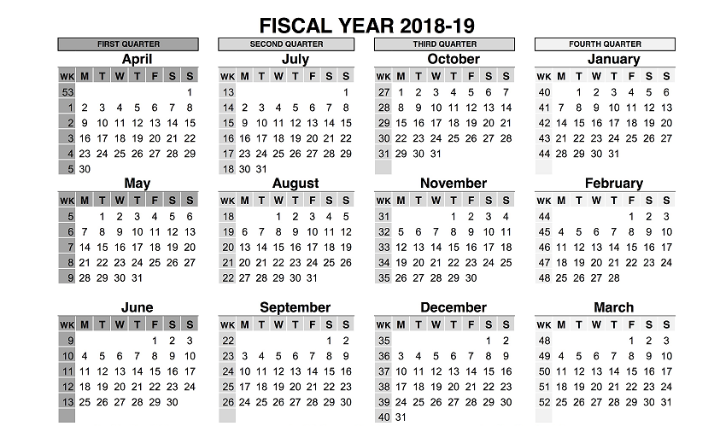
Visualization of Services in Matrix
Matrix lens
3 encounters with GPs
4 emergency department visits
2 inpatient hospitalizations
Long-term care admission
GP visits
Not the Matrix lens
Sequencing of encounters
Location of services
Health conditions treated

Slide 13
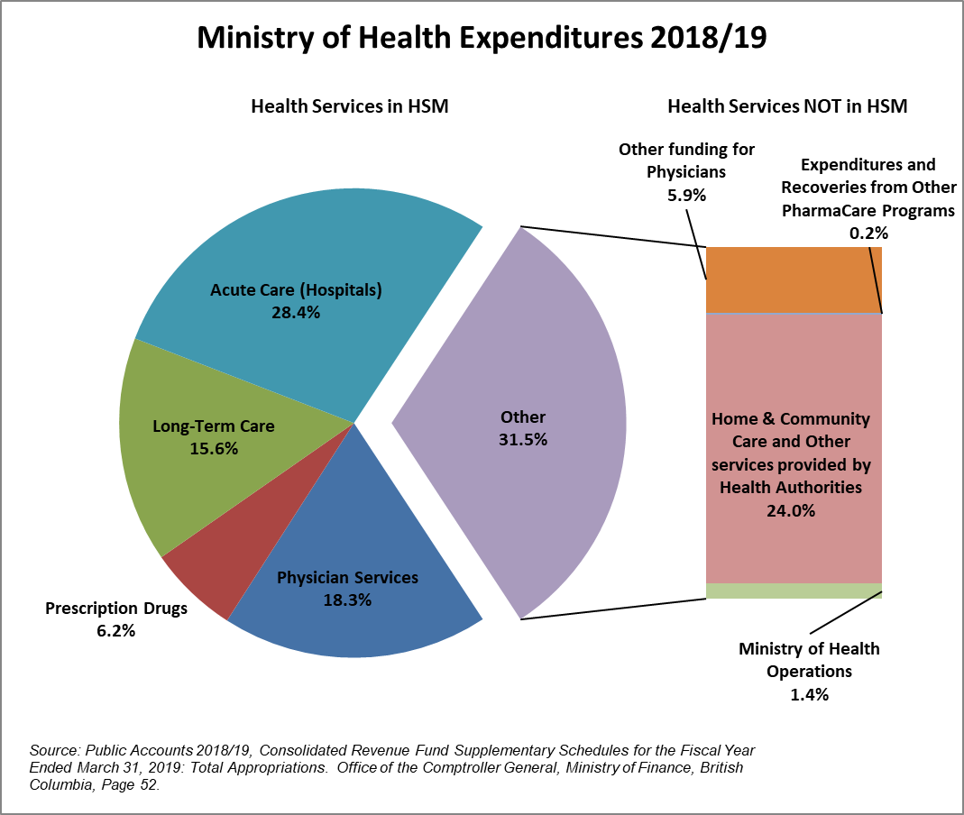
Health Care Expenditures in Matrix
In 2018/19 the Matrix only accounts for approximately $13.6 billion in publicly funded health care services provided for that fiscal year, or 68% of the Ministry’s expenditures.

Slide 14
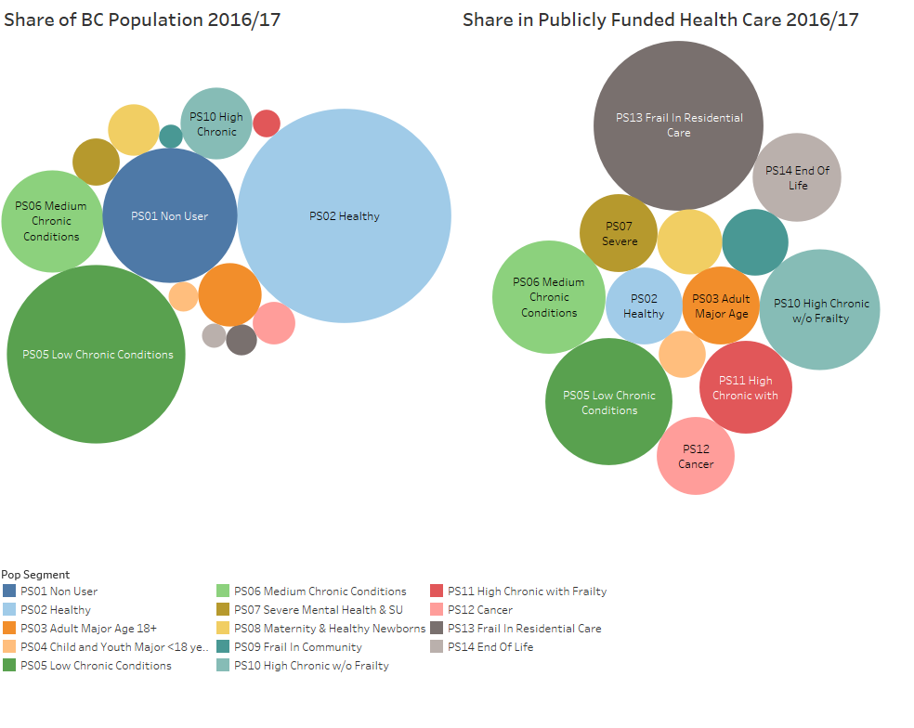
Population Segment vs Health Care Use Summarized in the Matrix
Population segments are a BC Ministry of Health product, built with both diagnostic and utilization information from administrative records

Slide 15
What is CIHI’s Population Grouping Methodology or CPOP?
Case-mix classification
Nationally available, developed by experts at CIHI with decades of case mix experience
Launched in 2016
Pop Grouper has received multiple international awards in recognition of its value for patient classification
Profiles each person using person-level clinical information over time
Clinically similar, cost homogenous groups
Includes entire population
Made-in-Canada equivalent to the John Hopkins Adjusted Clinical Grouping (ACG) system
With B.C. modifications

Slide 16
Diagnoses
Emergency room visits
Hospital abstracts
Physician Billing
Long-term care assessments
The process starts by linking diagnosis codes from each patient’s administrative records over
2 years and tagging each patient with various
health conditions
Health conditions

Slide 17
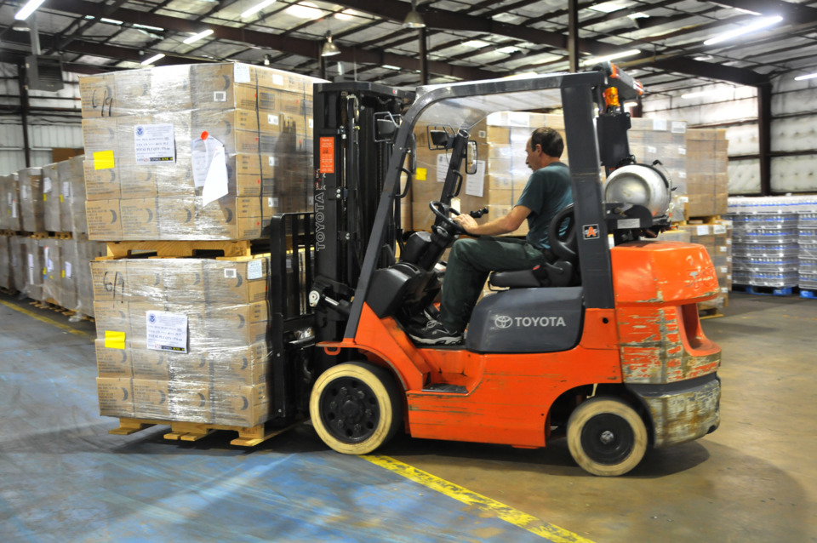
Health conditions
zero, one or more ‘tags’ per person per time period
Health Profile Groups
one ‘box’ per person per time period
Health Profile Group
Categories
Boxes grouped, like ‘pallets’
Notes:
If you’re forgive the somewhat industrial metaphors,
I like to think of the components of CIHI’s Grouping Methodology in these terms…
Health conditions are like tags, each person can have more than one health condition tagged to them, or none at all, during a given time period
Health profile groups are like boxes, because each person is ‘put’ in only one box.
This can also be called a case-mix classification, for folks familiar with that term
The Health Profile group categories are like pallets, because it is a way of grouping boxes together into high-level clinical groups, even though the needs of the people in each box are quite different, the higher level grouping is important to be able to paint a high-level picture, or work with a manageable number of groups for analysis and graphical visualization

Slide 18
Together creating different lenses for profiling morbidity (burden of disease) for
Demographic groups,
Health regions,
Physician rosters, or
The province as a whole

Slide 19
Health Conditions (HC) Additive classification
Diabetes (J02)
CV disease (E06)
Dementia (Q01)
Glaucoma (B06)
No conditions
Parkinson’s (A01)
Basic idea: HCs help create a unique morbidity profile for each person, and allow us to monitor population health based on health status/disease analysis

Slide 20
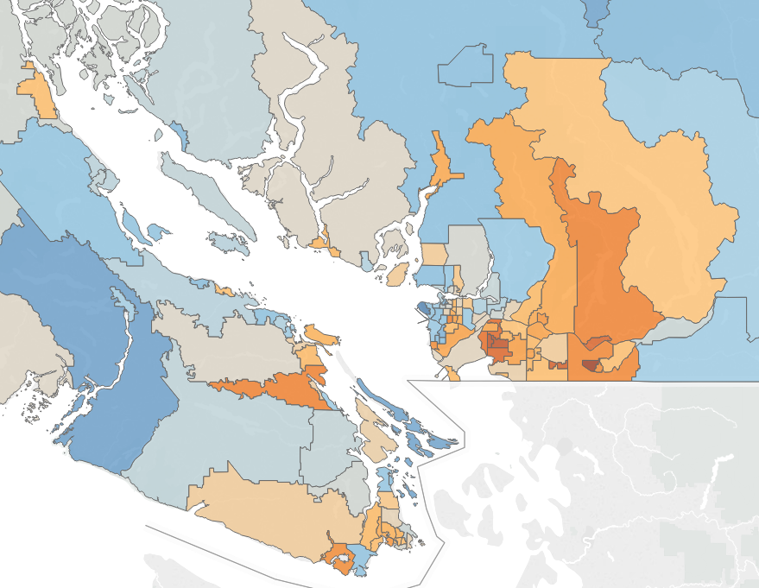
Health condition information can be used to monitor population health
D06 – Asthma
Percent of population
Considers utilization over past two years
Similar analysis can be done for any of the 227 health conditions on distribution, utilization, prediction/forecast
* Source: 2017/18 chronic disease data from Matrix V10
Notes:
Percentage of population with Asthma
The range is between 0.3% and 3.3%.
Possible explanations:
Population density and age diversity
Air quality

Slide 21
Health Profile Groups (HPG) Mutually exclusive classification
Based on each person’s highest ranked health condition(s), or lack thereof, and the presence of significant comorbidities
Q007
Dementia
(incl. Alzheimer's)
w/ sig comorbidities
B052C
Chronic Vision
Impairment
Z098
Health System
Non-User
A010C
Parkinson's Disease
/Parkinsonism
w/o sig comorbidities
Basic idea: Patients in the same HPG have similar healthcare needs

Slide 22
Most Costly Health Profile Groups by average estimate of publicly funded expenditures
Number of Persons
One-year cost estimate (average)
* Source: 2017/18 BC expenditure from Matrix V10
22

Slide 23
Health Profile Group Categories Broader mutually exclusive classification
Major Mental Health
Minor Chronic
Non-User
Major Chronic
Basic idea: Allows us to profile the population with a small number of groups
23

Slide 24
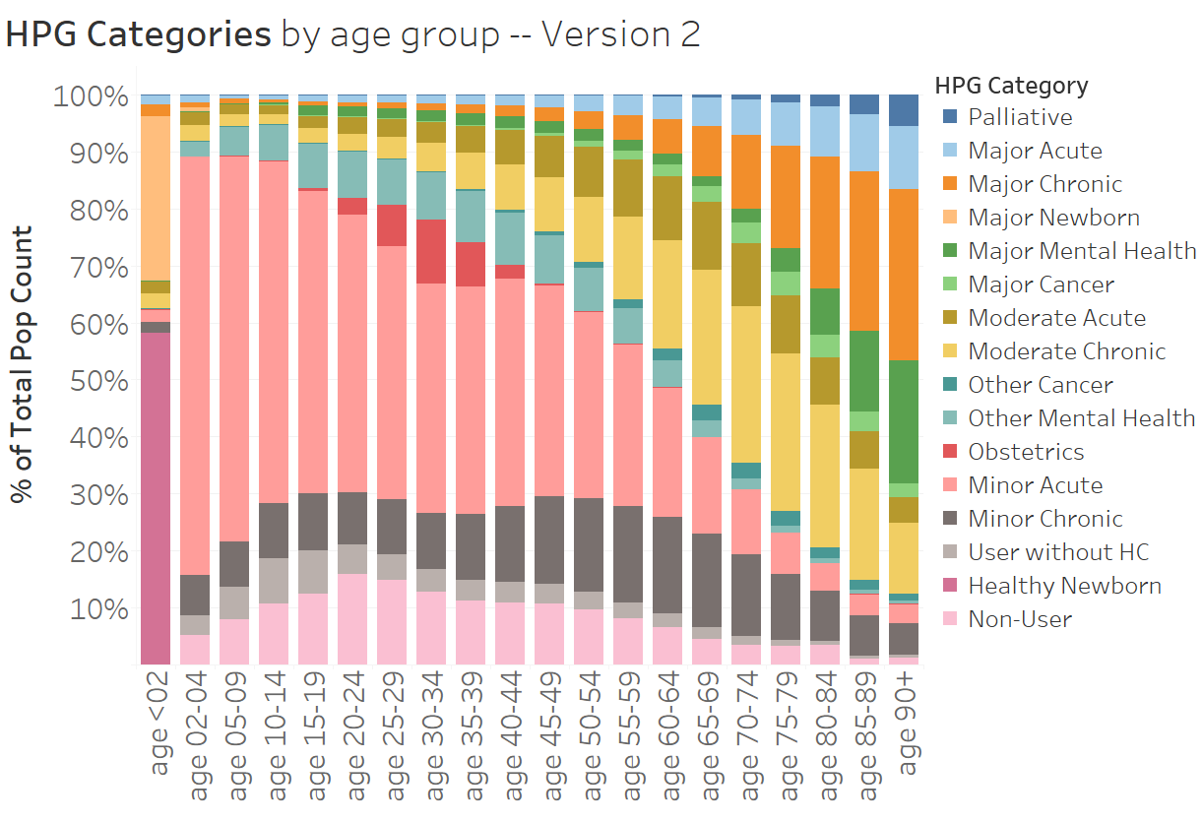
Percentage of population by category and age
* Source: 2018/19 BC data from CPOP V2019

Slide 25
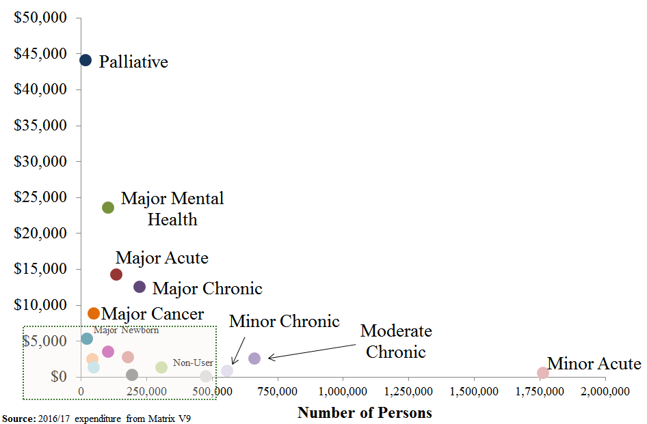
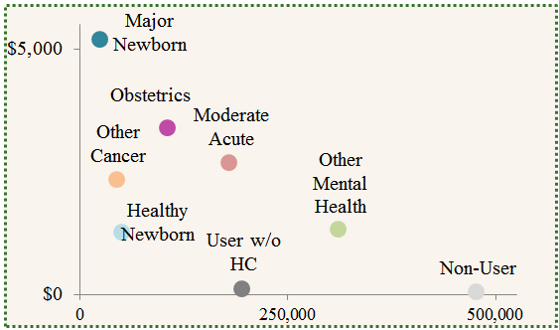
HPG Categories Costs per person versus population count
Notes:
Some examples:
Major acute: stroke without paralytic syndrome
Major chronic: stroke with paralytic syndrome
Moderate acute: Appendicitis
Moderate chronic: epilepsy
Minor acute: cold
Minor chronic: asthma
Major cancer: brain cancer, lung cancer
Minor cancer: skin cancer, breast cancer, prostate cancer

Slide 26
Derived dataset applications
Information summation, allowing for digestible high-level analysis of trends in patient population across the province, e.g., health monitoring, epidemiology, cost trends
Risk adjustment, enabling analysis, comparison and forecasting of relative health need and probable cost
Funding, i.e., capitation and population-based models
Targeted service planning, i.e., to create programs that meet specific health needs and avoid more costly health problems
Identification of target cohorts of patients for interventions
Other application to specific research questions and population modeling projects, including evaluation

Slide 27
COVID-19 daily hospitalization forecasts based on a logistic model
Methodology
Data Source
Clinical Characteristics
Logistic regression
Results
Goodness of fit
Positive cohort vs. population cohort
Validation
Application
CHSA profile
Hospitalization forecast

Slide 28
Data Sources
Information | Source
COVID-19 Positive cases | BC Centre for Disease Control COVID-19 Data in Healthideas
Patient demographics (age, sex, location) | Client Roster (2019/20)
Health conditions | CIHI’s Population Grouping Methodology (2019/20)
COVID-19 Hospitalizations and Deaths | BC Centre for Disease Control COVID-19 Data in Healthideas
BC Population | Client Roster (2019/20)
Long-Term Care (LTC) | PharmaNet Plan B (Long-Term Care Drug Plan) and HCC MRR
Social economic status (SES) | Canadian Index of Multiple Deprivation (CIMD) (not significant)

Slide 29
Clinical Characteristic for COVID-19
At-risk health conditions from Canadian Institute for Health Information (CIHI)
Code | At-risk condition
HC1 | Chronic lung/respiratory diseases
HC2 | Severe chest conditions
HC3 | Serious heart conditions
HC4 | Immunocompromised (exclude transplant)
HC5 | Severe obesity
HC6 | Diabetes
HC7 | Chronic kidney disease
HC8 | Liver disease
HC9 | Pregnancy
HC10 | Hypertension
HC11 | Cancer
HC12 | Chronic neurological conditions (include Dementia and Alzheimer's)
HC13 | Problems with spleen
HC14 | Transplant Recipient and complication
HC15 | Rheumatoid & Other Inflammatory Arthropathy (excl. Gout)

Slide 30
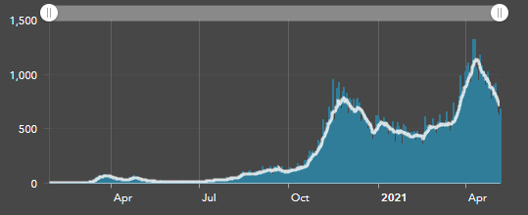
BC COVID-19 seven-day moving average
COVID-19 total cases

Slide 31
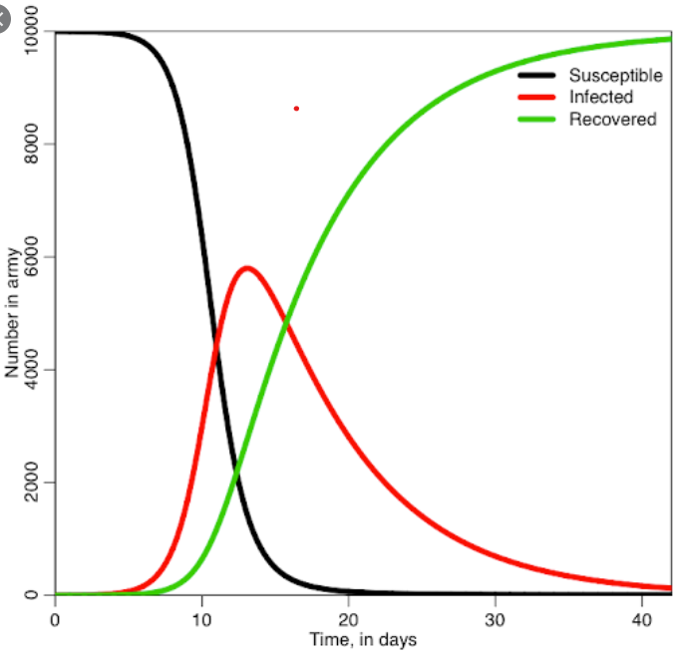
Why Logit?
Focus on severe outcomes and consider the balance between model complexity and accuracy
Simulation model: whole timeline, aggregated level mainly
Compartmental model: Susceptible, Exposed, Infectious, Recovered/Deceased
Full spatial model: rely on availability and accuracy of data and parameters
Difficult to model COVID-19 positive cases
Non symptoms, personal endurance, accessibility, test popularity
Our work
Hospitalizations or deaths if contracting COVID-19
Cohort: either people tested COVID-19 positive or BC whole population
References: Alina S, Marcy C, Gerardo S, Toyin A. Identifying Patients with Increased Risk of Severe COVID-19 Complications: Building an Actionable Rules-Based Model for Care Teams. https://catalyst.nejm.org/doi/full/10.1056/CAT.20.0116

Slide 32
Logistic regression methodology
Dependent variable: hospitalization; death; or both
Cohorts: positive only; whole population; with or without Long Term Care
Independent variable (predictors): age, sex, at-risk health conditions and interactions, risk group, long term care indicator, and combinations; social economic status (area-baed)
Interactions: examined in positive cohort but not in population cohort
Model selection: backward selection
P-value cut-off: 0.1
Model evaluation: C-statistic; 70/30 percent split; 10% resampling

Slide 33
Explanatory Analysis
Model cohort
COVID-19 positive cohort versus whole population cohort
COVID-19 positive cohort
Better accuracy
Fast run
May be biased when extrapolated to whole population
Population cohort
Obtaining population estimates directly
Slow run
May be limited by data availability and model accuracy
Factor analysis: either cohort is good
Population estimates: using population cohort when feasible/available
Suggestion: using both for a comparison

Slide 34
Model goodness of fit
C-statistic of Predicted Variable
Cohort | Risk factors | Hospitalization | Death | Hospitalization or death
Positive-cohort models (incl. all positive diagnoses; n = 48,989 as of Dec 31, 2020) | Age & sex only | .80 | .96 | .84
 | HC only | .73 | .90 | .77
 | Age, sex, LTC, HC | .83 | .96 | .85
 | Age, sex, LTC, HC, 2-way interaction | .73 | .97 | .85
Population-cohort models (incl. all B.C. residents; N = 5,200,204 for 2019/20 BC population) | Age & sex only | .76 | .94 | .79
 | HC only | .74 | .91 | .77
 | Age, sex, LTC, HC | .79 | .97 | .82
C statistic > 0.7: good model
C statistic > 0.8: strong model

Slide 35
Model results Age & sex only for COVID-19 hospitalization/death
Age and sex alone are strong predictors
Sex: males are 30% more likely be hospitalized or resulting death than females
Age: relative odds ratio compared to ages under 20 group
* COVID positive cohort model as of Dec 31, 2020

Slide 36
Model results Health conditions only for hospitalization or death
HC05: insignificant in BC; HC09: odds ratio <1; HC14: significant; HC11: different in the 2 models
Parameter | Univariate model |  | Positive model |  |  |  | Population model
 | (N=48,989) |  | (N=48,989) |  |  |  | (N=5,200,204)
 | OR [95% CI] |  | Estimate |  | OR [95% CI] |  | Estimate |  | OR [95% CI]
HC1 Respiratory diseases | 3.95 [3.54 - 4.42] |  | 0.78 | *** | 2.19 [1.93 - 2.48] |  | 0.50 | *** | 1.65 [1.46 - 1.87]
HC2 Severe chest conditions | -- |  | -- |  |  |  | --
HC3 Heart conditions | 6.88 [6.32 - 7.49] |  | 0.92 | *** | 2.52 [2.28 - 2.79] |  | 0.73 | *** | 2.08 [1.88 - 2.3]
HC4 Immunocompromised | 3.4 [2.62 - 4.42] |  | 0.64 | *** | 1.89 [1.4 - 2.57] |  | 0.28 |  | 1.32 [0.99 - 1.76]
HC5 Obesity | -- |  | -- |  |  |  | --
HC6 Diabetes mellitus | 5.14 [4.75 - 5.57] |  | 1.00 | *** | 2.72 [2.48 - 2.98] |  | 1.09 | *** | 2.96 [2.7 - 3.26]
HC7 Chronic kidney disease | 10.66 [9.46 - 12.01] |  | 0.94 | *** | 2.56 [2.22 - 2.94] |  | 0.66 | *** | 1.94 [1.71 - 2.2]
HC8 Liver disease | 4.82 [3.67 - 6.33] |  | 0.70 | *** | 2.02 [1.46 - 2.78] |  | 0.58 | *** | 1.79 [1.34 - 2.4]
HC9 Pregnancy | 1.37 [1.04 - 1.81] | † | -0.26 | * | 0.77 [0.59 - 1.01] |  | --
HC10 Hypertension | 3.74 [3.46 - 4.05] |  | 0.69 | *** | 1.99 [1.82 - 2.17] |  | 0.60 | *** | 1.82 [1.67 - 1.99]
HC11 Cancer | 4.07 [3.57 - 4.65] |  | 0.63 | *** | 1.88 [1.61 - 2.19] |  | --
HC12 Chronic neurological conditions | 7.99 [7.31 - 8.75] |  | 1.21 | *** | 3.36 [3.02 - 3.73] |  | 1.69 | *** | 5.43 [4.92 - 5.99]
HC13 Problems with spleen | 7.76 [1.85 - 32.46] |  | -- |  |  |  | 1.36 | * | 3.91 [1.22 - 12.53]
HC14 Transplant recipient and complication | 6.37 [3.98 - 10.2] |  | 0.97 | ** | 2.63 [1.5 - 4.61] |  | 0.46 | * | 1.58 [0.99 - 2.54]
HC15 Rheumatoid & other inflammatory arthropathy (excl. gout) | 3.21 [2.6 - 3.96] |  | 0.59 | *** | 1.8 [1.42 - 2.29] |  | 0.54 | *** | 1.71 [1.36 - 2.16]
p ≤ .05; ** p ≤ .01; *** p ≤ .001
† OR calculated from model including only females aged 16-60 (n=17,856).

Slide 37
Model results Full model – positive cohort with interaction
 | Positive cohort model (w/ 2-way interactions; n=48,989)
Factor | Estimate |  | OR [95% CI]
Age < 20 | --
20 - 39 | 1.03 | *** | 2.8 [2.07 - 3.78]
40 - 49 | 1.64 | *** | 5.14 [3.78 - 6.99]
50 - 59 | 2.15 | *** | 8.55 [6.33 - 11.56]
60 - 69 | 2.81 | *** | 16.66 [12.32 - 22.51]
70 - 79 | 3.65 | *** | 38.54 [28.43 - 52.25]
Age 80+ | 4.32 | *** | 75.55 [55.33 - 103.16]
Female | -0.39 | *** | 0.68 [0.63 - 0.74]
Long-term care indicator | -0.59 | *** | 0.55 [0.47 - 0.65]
HC1 Respiratory diseases | 0.69 | *** | †
HC2 Severe chest conditions | --
HC3 Heart conditions | 0.52 | *** | †
HC4 Immunocompromised | 0.71 | *** | †
HC5 Obesity | --
HC6 Diabetes mellitus | 0.54 | *** | †
HC7 Chronic kidney disease | 0.47 | *** | †
HC8 Liver disease | 1.34 | *** | †
HC9 Pregnancy | 0.67 | *** | †
HC10 Hypertension | 0.08 |  | †
HC11 Cancer | 0.01 |  | †
HC12 Chronic neurological conditions | 0.97 | *** | †
HC13 Problems with spleen | --
HC14 Transplant recipient and complication | 1.46 | *** | 4.33 [2.46 - 7.6]
HC15 Rheumatoid & other inflammatory arthropathy (excl. gout) | 0.45 | ** | †
 | Positive cohort model (w/ 2-way interactions; n=48,989)
Factor | Estimate |  | OR [95% CI]
HC12*HC15 | -0.78 | *
HC12*HC8 | -1.28 | **
HC12*HC7 | -0.55 | **
HC12*HC6 | -0.19
HC12*HC3 | -0.32 | **
HC12*HC1 | -0.77 | ***
HC10*HC11 | 0.28
HC10*HC7 | 0.32 | *
HC10*HC6 | -0.17
HC10*HC3 | -0.48 | ***
HC8*HC9 | 1.45 | *
HC8*HC6 | -0.83 | *
HC6*HC4 | -0.76 | *
HC10 Hypertension becomes insignificant when age in the model
It remains in the model due to interaction
Odds ratios are not given in the model for HCs with interactions due to complexity
C statistic is a bit higher
† OR [95% CI] omitted, as the corresponding HC is involved in one or more significant interactions.

Slide 38
Model results Full model without interaction to compare two cohorts
Factor | Positive cohort model (interactions excluded; n=48,989) |  |  |  | Population cohort model (interactions excluded; N = 5,200,204)
 | Estimate |  | OR [95% CI] |  | Estimate |  | OR [95% CI]
Age < 20 | -- |  |  |  | --
20 - 39 | 1.02 | *** | 2.79 [2.06 - 3.76] |  | 1.62 | *** | 5.05 [3.51 - 7.27]
40 - 49 | 1.66 | *** | 5.25 [3.86 - 7.13] |  | 2.1 | *** | 8.14 [5.62 - 11.79]
50 - 59 | 2.19 | *** | 8.94 [6.63 - 12.06] |  | 2.4 | *** | 11.05 [7.71 - 15.83]
60 - 69 | 2.89 | *** | 18.01 [13.37 - 24.26] |  | 2.49 | *** | 12.1 [8.45 - 17.32]
70 - 79 | 3.76 | *** | 42.85 [31.75 - 57.82] |  | 2.97 | *** | 19.5 [13.64 - 27.88]
Age 80+ | 4.47 | *** | 87.50 [64.42 - 118.86] |  | 3.44 | *** | 31.32 [21.87 - 44.87]
Female | -0.39 | *** | 0.68 [0.63 - 0.74] |  | -0.37 | *** | 0.69 [0.64 - 0.75]
Long-term care indicator | -0.64 | *** | 0.53 [0.45 - 0.62] |  | 1.64 | *** | 5.15 [4.44 - 5.97]
HC1 Respiratory diseases | 0.51 | *** | 1.66 [1.45 - 1.89] |  | 0.32 | *** | 1.37 [1.21 - 1.55]
HC2 Severe chest conditions | -- |  |  |  | --
HC3 Heart conditions | 0.25 | *** | 1.28 [1.15 - 1.42] |  | 0.26 | *** | 1.3 [1.17 - 1.44]
HC4 Immunocompromised | 0.58 | ** | 1.79 [1.32 - 2.43] |  | --
HC5 Obesity | -- |  |  |  | 0.4 | * | 1.49 [1.08 - 2.05]
HC6 Diabetes mellitus | 0.43 | *** | 1.53 [1.4 - 1.68] |  | 0.76 | *** | 2.14 [1.95 - 2.35]
HC7 Chronic kidney disease | 0.42 | *** | 1.52 [1.32 - 1.74] |  | 0.36 | *** | 1.43 [1.26 - 1.62]
HC8 Liver disease | 0.83 | *** | 2.29 [1.67 - 3.16] |  | 0.6 | *** | 1.82 [1.36 - 2.44]
HC9 Pregnancy | 0.74 | *** | 2.09 [1.58 - 2.76] |  | 0.63 | ** | 1.87 [1.32 - 2.65]
HC10 Hypertension | -- |  |  |  | 0.14 | ** | 1.15 [1.05 - 1.26]
HC11 Cancer | -- |  |  |  | -0.21 | ** | 0.81 [0.7 - 0.94]
HC12 Chronic neurological conditions | 0.55 | *** | 1.74 [1.5 - 2.02] |  | 0.67 | *** | 1.96 [1.71 - 2.24]
HC13 Problems with spleen | 1.57 |  | 4.79 [0.77 - 29.76] |  | 1.69 | ** | 5.43 [1.69 - 17.43]
HC14 Transplant recipient and complication | 1.51 | ** | 4.52 [2.57 - 7.95] |  | 0.89 | ** | 2.42 [1.51 - 3.88]
HC15 Rheumatoid & other inflammatory arthropathy (excl. gout) | 0.35 | ** | 1.43 [1.12 - 1.82] |  | 0.57 | *** | 1.77 [1.41 - 2.22]
p ≤ .05; ** p ≤ .01; *** p ≤ .001

Slide 39
Model analysis and validation Decile
Positive cohort
Population cohort
 |  | Hospitalizations/deaths (predicted) |  |  |  | Hospitalizations/deaths (actual)
 | Percentile | Count | % | Rescaled count |  | Count | % | Rescaled count
High Risk: | 0-10% | 1,832.7 | 37.4% | 194,540 |  | 1,885 | 38.5% | 200,094
 | 10-20% | 485.7 | 9.9% | 51,556 |  | 516 | 10.5% | 54,774
 | 20-30% | 322.8 | 6.6% | 34,263 |  | 331 | 6.8% | 35,136
 | 30-40% | 242.9 | 5.0% | 25,779 |  | 180 | 3.7% | 19,107
 | 40-50% | 206.3 | 4.2% | 21,896 |  | 203 | 4.1% | 21,549
 | 50-60% | 149.9 | 3.1% | 15,915 |  | 91 | 1.9% | 9,660
 | 60-70% | 136.2 | 2.8% | 14,453 |  | 158 | 3.2% | 16,772
 | 70-80% | 95.1 | 1.9% | 10,099 |  | 107 | 2.2% | 11,358
 | 80-90% | 33.1 | 0.7% | 3,510 |  | 28 | 0.6% | 2,972
Low Risk: | 90-100% | 19.7 | 0.4% | 2,092 |  | 25 | 0.5% | 2,654
 | Totals: | 3,524.3 | 7.2% | 374,104 |  | 3,524 | 7.2% | 374,074
 |  | Hospitalizations/deaths (predicted) |  |  | Hospitalizations/deaths (actual)
 | Percentile | Count | % |  | Count | %
High Risk: | 0-10% | 1,878.3 | 38.3% |  | 1,880 | 38.4%
 | 10-20% | 623.7 | 12.7% |  | 652 | 13.3%
 | 20-30% | 310.1 | 6.3% |  | 332 | 6.8%
 | 30-40% | 202.0 | 4.1% |  | 178 | 3.6%
 | 40-50% | 142.4 | 2.9% |  | 141 | 2.9%
 | 50-60% | 106.2 | 2.2% |  | 94 | 1.9%
 | 60-70% | 102.8 | 2.1% |  | 78 | 1.6%
 | 70-80% | 71.6 | 1.5% |  | 81 | 1.7%
 | 80-90% | 57.2 | 1.2% |  | 59 | 1.2%
Low Risk: | 90-100% | 29.8 | 0.6% |  | 29 | 0.6%
 | Totals: | 3,524.0 | 7.2% |  | 3,524 | 7.2%
More than half of COVID-9 hospitalizations in BC (1,880 and 1,885 of 3,524 in positive- and population-cohort models, respectively) are attributable to those in the highest-risk decile
People in this decile have a nearly 40% chance to be hospitalized or die should they become ill with COVID-19

Slide 40
Model Application CHSA profile
Service areas in B.C.:
Health Authority (HA), Health Service Delivery Area (HSDA), Local Health Area (LHA), and Community Health Service Area (CHSA)
Aim: Understand where outbreaks may result in a higher proportion of hospitalizations or deaths
Calculate risk probabilities on individual level using model coefficients
The probability that an individual will be hospitalized or die if they test positive for COVID-19. Rescaling by the proportion of total positive cases over BC population if using population cohort
Roll up to CHSA to get the average probability per CHSA resident
The average chance among residents of hospitalization or death if residents test positive.
Compare with overall B.C. average to get scores
Such as: risk scores from 0.6 to 1.8 if B.C. average = 1
Also given by 5 categories

Slide 41
CHSA relative risk – population quintile CHSA profile
Represents hypothetical risk of severe outcomes from COVID-19 should an outbreak occur, all other factors being equal.
Positive cohort
Population cohort

Slide 42
Methodology for daily hospitalization forecast Daily hospitalization forecast
Date range for model training
Balance between accuracy and timing
8-week, 6-week, and 4-week inputs were tested
Most recent rolling 4-week data has been used. No advanced analysis on time frame selection
frequently check weekly hospitalizations in order to accordingly adjust the time period of data, if needed, used in the modeling
HAs as predictors
Drive the model heavily skewed to FHA and VCHA
Almost all CHSAs in FHA and VCHA become high risk
Model verification
Generally good
Cannot fit daily fluctuations

Slide 43
Procedures Daily hospitalization forecast
Fit the rolling 4-week model
Generate risk categories based on ventiles, see tables later
Obtain daily/weekly COVID-19 positive cases from BCCDC daily feed
Apply model coefficients to these cases to obtain their hospitalization probability, and categorize them into risk categories
Sum up the probabilities to HA or facility level

Slide 44
Four-week rolling model (Jan 21, 2021 - Feb 17, 2021) Daily hospitalization forecast
Factors | Estimate |  | OR [95% CI]
Age
<20 | --
20-39 | 2.13 | *** | 8.42 [3.04 - 23.36]
40-49 | 2.95 | *** | 19.09 [6.91 - 52.74]
50-59 | 2.49 | *** | 12.06 [4.32 - 33.67]
60-69 | 3.04 | *** | 21 [7.67 - 57.5]
70-79 | 3.24 | *** | 25.46 [9.26 - 70.02]
80+ | 3.44 | *** | 31.24 [11.24 - 86.84]
Sex
Female | -0.27 | *** | 0.77 [0.63 - 0.94]
Health factors
Long-term care status | -1.16 | ** | 0.31 [0.13 - 0.74]
HC1 (Respiratory diseases) | 0.92 | *** | 2.51 [1.91 - 3.29]
HC2 (Severe chest conditions) | --
HC3 (Heart conditions) | 0.41 | ** | 1.51 [1.16 - 1.95]
HC4 (Immunocompromised) | 0.61 | * | 1.85 [1.01 - 3.38]
HC5 (Obesity) | --
HC6 (Diabetes mellitus) | 0.81 | *** | 2.26 [1.78 - 2.86]
HC7 (Chronic kidney disease) | 0.78 | *** | 2.19 [1.61 - 2.97]
HC8 (Liver disease) | 1.43 | *** | 4.19 [2.51 - 6.98]
HC9 (Pregnancy) | --
HC10 (Hypertension) | --
HC11 (Cancer) | --
HC12 (Chronic neurological conditions) | 0.59 | ** | 1.81 [1.28 - 2.57]
HC13 (Problems with spleen) | 1.93 |  | 6.89 [0.94 - 50.39]
HC14 (Transplant Recipient and complication) | --
HC15 (Rheumatoid & Other Inflammatory Arthropathy (excl. Gout)) | 0.69 | ** | 1.99 [1.20 – 3.30]
C statistic = .80; Somer’s D = .6; Gamma = .61
*p≤.05, ** p<.01, *** p<.001
Odds ratio for LTC residents drops below 1 because of priority protective measures

Slide 45
Ventile based on probability ( 4-week model Jan 21, 2021 - Feb 17, 2021) Daily hospitalization forecast
 |  | Forecast hospitalizations |  |  | Actual hospitalizations
Ventile(s) | Risk Group | Rate | Count |  | Rate | Count |  | Error
1 | Very High | 33.4% | 188.5 |  | 32.8% | 185 |  | -0.6%
2 | High | 12.2% | 68.9 |  | 13.1% | 74 |  | 0.9%
3 | High | 8.2% | 46.3 |  | 10.3% | 58 |  | 2.1%
4 | High | 6.3% | 35.5 |  | 6.2% | 35 |  | -0.1%
5 | Medium | 5.6% | 31.4 |  | 8.2% | 46 |  | 2.6%
6 | Medium | 5.2% | 29.5 |  | 4.1% | 23 |  | -1.1%
7 | Medium | 4.6% | 26 |  | 1.1% | 6 |  | -3.5%
8 | Medium | 4.1% | 23.3 |  | 3.5% | 20 |  | -0.6%
9 | Medium | 3.7% | 20.8 |  | 5.0% | 28 |  | 1.3%
10 | Medium | 3.1% | 17.3 |  | 3.9% | 22 |  | 0.8%
11 | Medium | 2.5% | 14.1 |  | 1.8% | 10 |  | -0.7%
12 | Low | 2.3% | 13 |  | 0.0% | 0 |  | -2.3%
13 | Low | 2.3% | 13 |  | 2.5% | 14 |  | 0.2%
14 | Low | 2.0% | 11.5 |  | 2.3% | 13 |  | 0.3%
15 | Low | 1.8% | 9.9 |  | 0.0% | 0 |  | -1.8%
16 | Low | 1.8% | 9.9 |  | 3.5% | 20 |  | 1.7%
17 | Very Low | 0.5% | 2.9 |  | 0.7% | 4 |  | 0.2%
18 | Very Low | 0.3% | 1.5 |  | 0.2% | 1 |  | -0.1%
19 | Very Low | 0.2% | 1.3 |  | 0.2% | 1 |  | 0.0%
20 | Very Low | 0.2% | 1.2 |  | 0.7% | 4 |  | 0.5%
1 | Very High | 33.45% | 188.5 |  | 32.80% | 185 |  | -0.7%
2-4 | High | 8.90% | 150.7 |  | 9.87% | 167 |  | 1.0%
5-11 | Medium | 4.11% | 162.4 |  | 3.94% | 155 |  | -0.2%
12-16 | Low | 2.04% | 57.3 |  | 1.66% | 47 |  | -0.4%
17-20 | Very Low | 0.30% | 6.9 |  | 0.45% | 10 |  | 0.2%

Slide 46
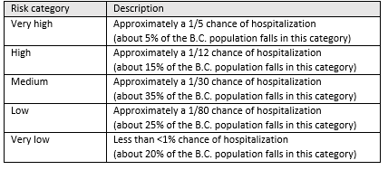
Hospitalization risk by geographic region Daily ever hospitalization forecast
Cases reported on February 19, 2021 (using 4-week model of Jan 21, 2021 - Feb 17, 2021)
 | New cases by risk group |  |  |  |  |  | Hospitalizations
Health Authority | Very low | Low | Medium | High | Very high | Total new cases | Forecast | Actual
1 (Interior) | 1 | 9 | 7 | 2 | 2 | 21 | 1.1 | 1
2 (Fraser) | 53 | 98 | 70 | 28 | 15 | 264 | 12.5 | 8
3 (Vancouver Coastal) | 23 | 44 | 41 | 13 | 5 | 126 | 6.1 | 6
4 (Vancouver Island) | 16 | 20 | 11 | 3 | 1 | 51 | 1.5 | 0
5 (Northern) | 6 | 13 | 17 | 6 | 1 | 43 | 1.7 | 4
All (B.C.) | 99 | 184 | 146 | 52 | 24 | 505 | 22.8 | 19
Hospital | Total new cases | Risk of hospitalization |  |  |  |  | Expected ever hospitalization by residency | Expected ever hospitalization by real flow
 |  | Very low | Low | Medium | High | Very high
756 East Kootenay Regional | 4 | 0 | 1 | 0 | 2 | 1 | 0.4 | 0.2
801 Kootenay Boundary Regional | 1 | 0 | 0 | 1 | 0 | 0 | 0.0 | 0.0
303 Penticton Regional | 7 | 1 | 4 | 2 | 0 | 0 | 0.2 | 0.2
401 Royal Inland | 9 | 0 | 4 | 4 | 0 | 1 | 0.5 | 0.5
609 Abbotsford Regional | 41 | 3 | 21 | 10 | 6 | 1 | 1.7 | 2.0
109 Royal Columbian | 101 | 22 | 32 | 31 | 9 | 7 | 4.8 | 4.4
116 Surrey Memorial | 122 | 28 | 45 | 29 | 13 | 7 | 6.1 | 5.8
121 Richmond | 14 | 1 | 3 | 8 | 1 | 1 | 1.0 | 1.0
101 Vancouver General, 102 St. Paul's | 93 | 17 | 37 | 25 | 10 | 4 | 4.3 | 4.8
112 Lions Gate | 19 | 5 | 4 | 8 | 2 | 0 | 0.7 | 0.7
201 Royal Jubilee, 202 Victoria General | 10 | 0 | 9 | 0 | 1 | 0 | 0.3 | 0.6
501 Nanaimo Regional General | 41 | 16 | 11 | 11 | 2 | 1 | 1.2 | 0.7
912 Mills Memorial | 29 | 4 | 8 | 14 | 2 | 1 | 1.2 | 1.0
703 The University of Northern BC | 8 | 1 | 3 | 1 | 3 | 0 | 0.3 | 0.4
701 Fort St. John General | 6 | 1 | 2 | 2 | 1 | 0 | 0.2 | 0.3
B.C. | 505 | 99 | 184 | 146 | 52 | 24 | 22.8 | 22.7

Slide 47
Verification – daily and weekly Daily hospitalization forecast
 | Hospitalizations
Reported Date | Forecast | Actual | % difference
2021-01-29 | 22.68 | 18 | 26%
2021-01-30 | 22.75 | 25 | -9%
2021-01-31 | 15.64 | 23 | -32%
2021-02-01 | 23.04 | 32 | -28%
2021-02-02 | 19.08 | 18 | 6%
2021-02-03 | 23.46 | 23 | 2%
2021-02-04 | 24.84 | 23 | 8%
Week 1 (Jan 29 - Feb 4) | 151.49 | 162 | -7%
2021-02-05 | 19 | 19 | 0%
2021-02-06 | 24.15 | 21 | 15%
2021-02-07 | 21.06 | 26 | -19%
2021-02-08 | 20.68 | 22 | -6%
2021-02-09 | 22.8 | 24 | -5%
2021-02-10 | 22.68 | 18 | 26%
2021-02-11 | 18 | 12 | 50%
Week 2 (Feb 5 - Feb 11) | 148.37 | 142 | 4%
2021-02-12 | 23.1 | 15 | 54%
2021-02-13 | 20 | 20 | 0%
2021-02-14 | 16.25 | 13 | 25%
2021-02-15 | 14.82 | 19 | -22%
2021-02-16 | 18.19 | 17 | 7%
2021-02-17 | 26.91 | 23 | 17%
2021-02-18 | 22.61 | 17 | 33%
Week 3 (Feb 12 - Feb 18) | 141.88 | 124 | 14%
2021-02-19 | 22.8 | 19 | 20%
2021-02-20 | 22.54 | 23 | -2%
2021-02-21 | 24.12 | 36 | -33%
2021-02-22 | 20.7 | 30 | -31%
2021-02-23 | 24 | 25 | -4%
2021-02-24 | 24.92 | 28 | -11%
2021-02-25 | 27.9 | 31 | -10%
Week 4 (Feb 19 - Feb 25) | 166.98 | 192 | -13%
Month (Jan 29 – Feb 25) | 608.72 | 620 | -2%

Slide 48
COVID-19 ICU admission forecast based on a negative binominal model
Methodology
Data source
Factors considered
Results
Model fit and forecast
Seven-day ICU forecast

Slide 49
Methodology ICU forecast
Capacity of intensive care units (ICU) is an ongoing concern for the health system in combatting the COVID-19 pandemic.
Based on Dr. Fisman and Tuite model (Ontario) with our modifications
Predictors for daily ICU admission
number of daily testing, number of daily positive cases, average age of the daily positive cases, average number of at-risk health conditions of the positive cases
Models
Negative binominal
Poisson
Different setups tested (3-,5-,7-,10-day window; 5-,7-,10-,15-day average; single health condition such as obesity (HC05) and pregnancy (HC09)) by comparing AIC value

Slide 50
Data sources ICU forecast
Information | Source
New daily COVID-positive ICU admissions | Provincial Health Services Authority (PHSA) daily report to the Ministry of Health (75-85% ICU cases collected)
COVID-19 positive cases and testing volumes | Provincial Laboratory Information System (PLIS) (using observation date)
Average case age | Client Roster
Number of at-risk health conditions for COVID-19 positive cases | CIHI’s Population Grouping Methodology (CPOP)

Slide 51
How it works ICU forecast
Use daily time series data on BC level to fit a negative binomial model:
COVID-19 ICU admission count = F (# of daily testing, # of daily COVID-19 positive cases, average age of the daily COVID-19 positive cases, Average # of at-risk health conditions of the positive cases)
There is a 7 day window between the dependent variable (COVID-19 ICU admissions) and the predictors based on AIC value and the fact that on average COVID-19 ICU admission date is 7 day lagged than COVID-19 reported date
This lag provides us the ability to make a 7 day forecast
For example, if we fit the model using daily ICU admissions up to April 14, 2021 corresponding to daily feeds of predictors up to April 7, 2021 (note the 7-day window matching), we can forecast daily ICU admissions for a week advanced (April 15 to April 21) using the daily feeds of predictors in April 8 to April 14 and the fitted model coefficients
A growth model with a time lag
Time frame does influence forecast

Slide 52
Factors considered ICU forecast
A 10-day moving average was used in model development.
There is a correlation between average age (middle graph) and average number of at-risk health conditions (bottom graph).
At the first wave, COVID-19 positive cohort was older with higher average age and # of HCs
May find significant HCs for ICU admission in BC to improve model.

Slide 53
Model fit and forecast ICU forecast
Results given in next slide

Slide 54
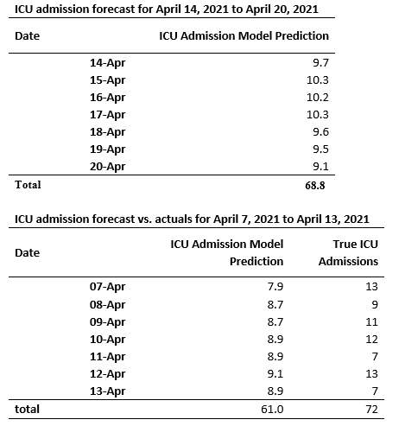
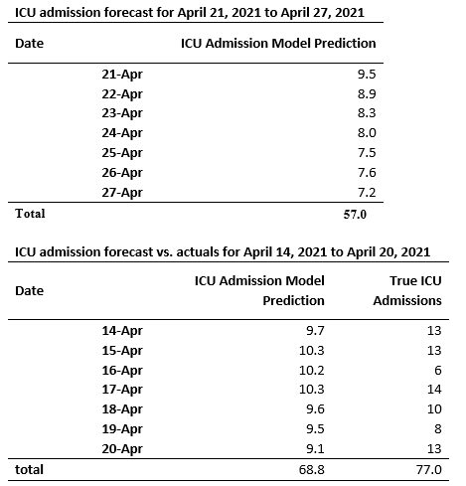
Seven-day ICU forecast ICU forecast

Slide 55
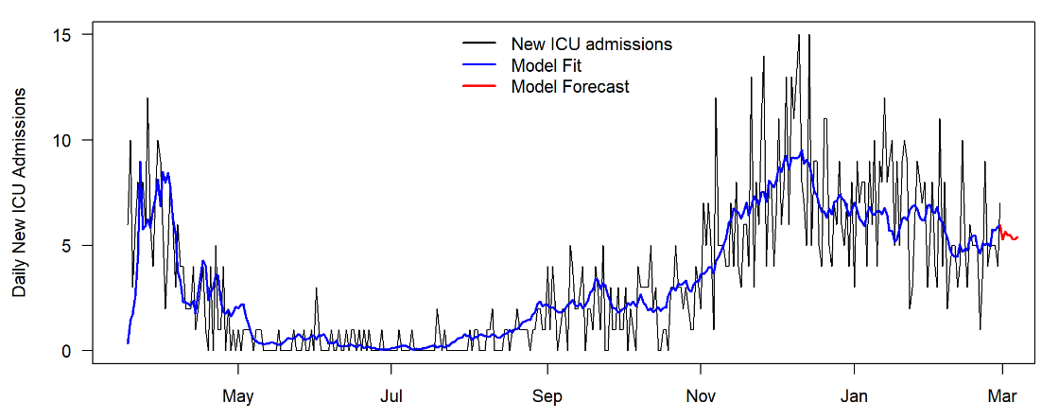
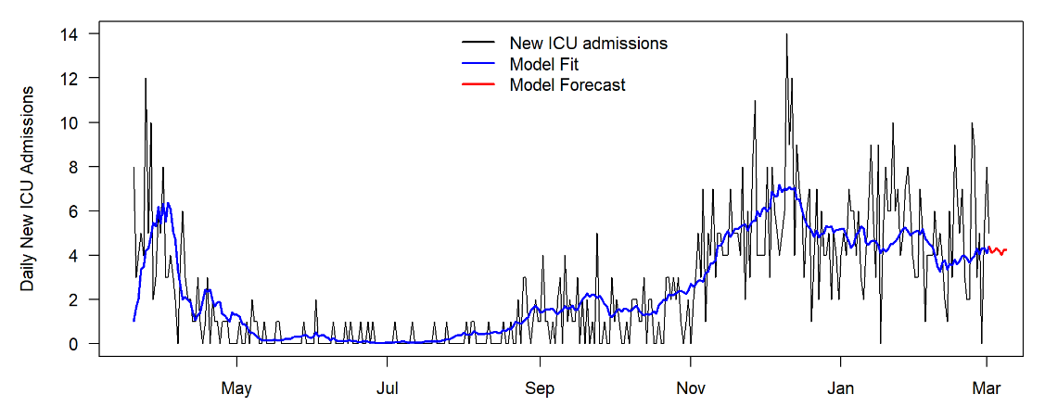
Comparison with ICU admissions from DAD ICU forecast
Discharge Abstract Database (DAD) has all ICU admissions, but it is lagged
PHSA does not capture all ICU admissions due to rush time and capacity limit
Utilize same setups to compare models using DAD or PHSA data feed as of Feb 28, 2021
DAD: total ICU admissions = 1,203
PHSA: total ICU admissions = 876

Slide 56
Limitations
Conditions may not be significant in the model because (1) they can’t be identified using administrative records, or (2) small number of case counts, including when vulnerable patients are cautious to avoid exposure.
No advanced algorism on time frame selection
Administrative data doesn’t replace clinical judgement
For more information: https://www2.gov.bc.ca/gov/content/covid-19/vaccine/cev

Slide 57
Our Team
Project leads
Samantha Magnus
Yongcai Liu
Work team
Anatoli Skripnitchenko
David Scott
Mengmeng Zhang
Saiganesh Dhannewar
Jason Flindall
Special thanks to
Martin Wright, ADM of HSIAR
Heather Richards, ED of PPM
Ognjenka Djurdjev from PHSA for discussions
Mengmeng Zhang for working on the slides

Slide 58
Questions?

